Slide 1
Estimación de Efectos Genéticos sociales Integrando fenómica de comportamiento
Juan Pedro Steibel
Departments of Animal Science and Fisheries and Wildlife
Michigan State University
GAB 2019
XXIV Reunión del Grupo Argentino de Biometría
Luján de Cuyo, Mendoza
Octubre de 2019

Slide 2




Agradecimiento
Colaboradores:
Dr. Catherine Ernst
Dr. Ronald Bates
Dr. Fito Cantet
Dr. Janice Siegford
Dr. Simon Turner
Dr. Tomas Norton
Mr. Chen Chen
Mr. Junjie Han
Ms. Belcy Angarita B.
Dr. Kaitlin Wurtz
US Pig Coordinator
Animal Agriculture Industry Coalition
This project was supported by Agriculture and Food Research Initiative Competitive Grants #:
2004-35604-14580 (PI: Ernst) 2014-68004-21952 (PI: Siegford)
2010-65205-20342 (PI: Steibel) 2017-67007-26176 (PI: Steibel)
2011-67015-30338 (PI: Tempelman)
from the USDA National Institute of Food and Agriculture.
Notes:
With that I would like to acknowledge the Michigan State Department of Animal Science, the National Swine Registry and the National Institute of Food and Agriculture for funding and supporting this research. I would further like to thank my advisor Dr. Steibel and my co-authors in this project for their input and support.
2

Slide 3
Organización de la presentación
Presentación del problema biológico:
caracteres de agresión y de bienestar en cerdos
Estimación de efectos genéticos directos y sociales
Conteo de lesiones resultado de la agresión
Fenómica
Recolección de datos de comportamiento
Detección automática de actividad usando Deep Learning
Detección automática de agresión usando Machine Learning
Datos de comederos automaticos para inferir efectos de competencia

Slide 4
Agresión en la crianza grupal de cerdos
En la producción comercial de cerdos es común la crianza grupal en las fases post-destete y crecimiento-terminación.
Incluso en la actualidad existe una tendencia a la crianza grupal de cerdas gestantes.
Por qué se presentan problemas de agresión? Acaso los cerdos no son animales sociales?
Notes:
All pigs in production are commonly housed in groups throughout their lives and remixed as they move through the various stages of production from farrowing through the nursery and into finishing units. Groups are formed based on factors such as gender and growth and in most cases, these pigs have never had contact with each other even through pen walls.
However, when pigs are abruptly mixed into such groups—which are not the small familial groups that would be found in wild pigs--we see a great deal of fighting—especially in the first few days.

Slide 5
Grupos en condiciones de producción.
Los grupos por corral se forman mezclando animales desconocidos entre sí.
Los grupos de contemporáneos son relativamente homogéneos por sexo, edad y tamaño/peso
Agrupar animales de esta forma facilita el manejo, pero dificulta el establecimiento de la jerarquía social.
Suelen generarse intensas peleas 24 a 72 horas post-mezcla.
Notes:
All pigs in production are commonly housed in groups throughout their lives and remixed as they move through the various stages of production from farrowing through the nursery and into finishing units. Groups are formed based on factors such as gender and growth and in most cases, these pigs have never had contact with each other even through pen walls.
However, when pigs are abruptly mixed into such groups—which are not the small familial groups that would be found in wild pigs--we see a great deal of fighting—especially in the first few days.

Slide 6
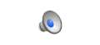
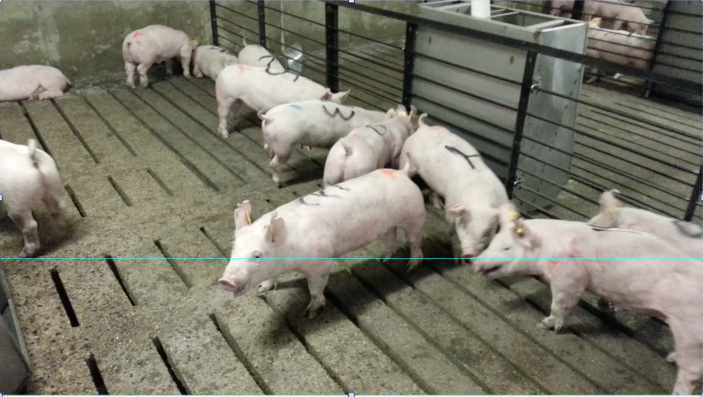
Behavior after Mixing into Finisher
Notes:
Link to Finisher Mix Video 1 fight

Slide 7
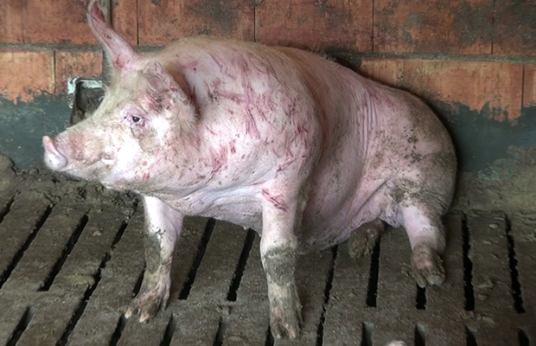
The Problem
Lesiones
Enfermedad
Alteraciones de Actividad
Estres post-natal
Consumo de Alimento
Conversion de Alimento
Tasa de Crecimiento
Exito reproductivo
Agresión intensa y/o persistente puede afecta seriamente el bienestar y la productivodad de cerdos en crianza colectiva
©CIWF
Notes:
The fighting leads to injuries, which are painful and can become infected and can also increase lameness and culling of sows

Slide 8
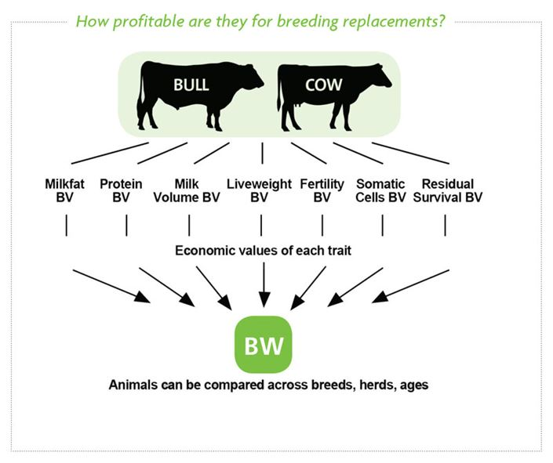
Soluciones via la seleccion genetica?
Las decisiones de selección y apareamiento suelen ser basadas en muchos caracteres.
Selección basada en
mejor temperamento
podría generar animales
que pelean menos?

Slide 9
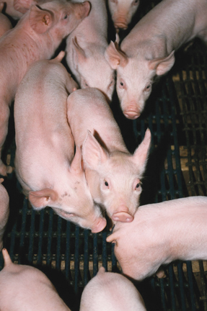
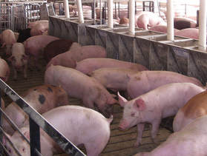
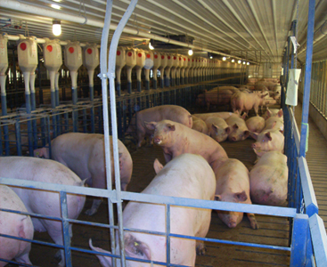
Metodología
560 cerdas primíparas + 560 machos castrados (purebred Yorkshire) re-mezclados en 3 edades
Conteo de lesiones antes, inmediatamente después y 3 semanas después de cada mezcla.
Blood, weights, backfat & loin muscle area
©Pork.org
©Pork.org
©Hog Slat Blog
Wurtz et al. 2017 (J. Anim. Sci 95(10):4310-4317)
Notes:
We have been assessing pigs at three ages.
After weaning
Start of grow-finish phase
Placement into breeding herds
We have been using not only gilts that could become replacement sows in breeding herds, but also their barrow littermates.

Slide 10
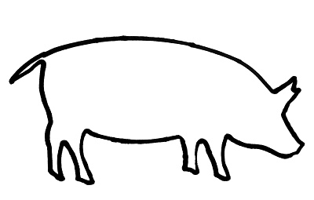
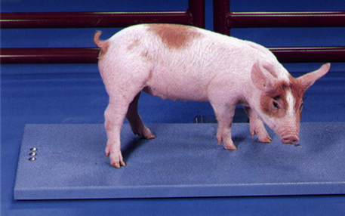
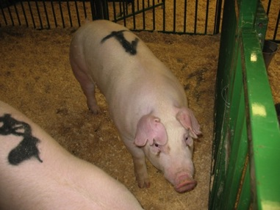
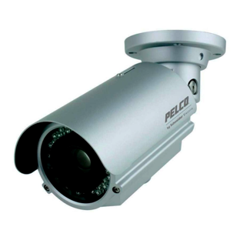
Fenotipo: Conteo de lesiones
Antes de mezclar en cada edad…
24 h and 3 wk despues de mezclar en cada edad…
Rear
Middle
Front
©Algen
©Janice Siegford, MSU ABWG
Rear
Middle
Front
Notes:
Prior to mixing at each age, we weigh the pigs to allocate them by prior group and weight to new groups.
Mark pigs to allow easy for identification
Count skin injuries
After mixing
Count skin injuries 24 h and 3 wk after mixing
We have installed cameras in rooms throughout the swine farm to capture pigs at the different stages.
Then we were able to record video for 24 h immediately and 3 wk after mixing

Slide 11
Variabilidad fenotipica en el conteo de lesiones
Lesiones Frontales inmediatamente post-mezcla hay un pico en el numero de lesiones y luego de 3 semanas el conteo de lesiones regresa a niveles pre-mezcla.
Pre-mix
24 hours
Post-mix
3 weeks Post-mix

Slide 12
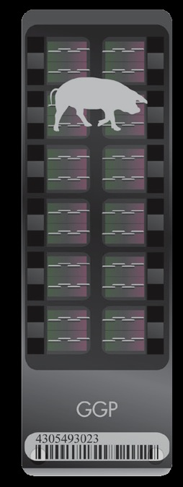
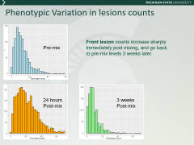
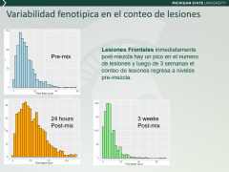
Analisis genómico
Genotipado con el chip 70K SNP GGP-HD
Error controlled by removing animals >10% missing data, markers with minor allele frequency of <5% and X chromosome
52,925 SNP y 1,079 animales
©Illumina
SNP = single nucleotide polymorphism
Notes:
We used the 70K GeneSeek Genomic Profiler Porcine HD chip for the animals in the study.
SNPs: most commonly, these variations are found in the DNA between genes. They can act as biological markers, helping locate genes or interest.
After obtaining the genotypes, we will use genomic selection models to estimate genetic parameters of interest and to perform genome wide analysis.

Slide 13
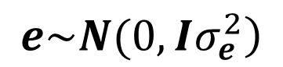
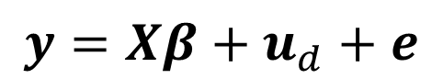
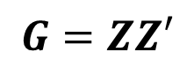
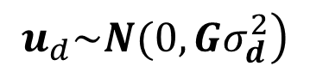
Estimacion de parámetros genéticos
$$y=Xβ+u_{d}+e$$
Matriz de genotipos
(animals en filas, marcadores en columnas)
$$\left.e\sim N(0,Iσ_{e}^{2}\right)$$
$$\left.u_{d}\sim N(0,Gσ_{d}^{2}\right)$$
$$G=ZZ′$$
Matriz de relaciones Genómicas

Slide 14
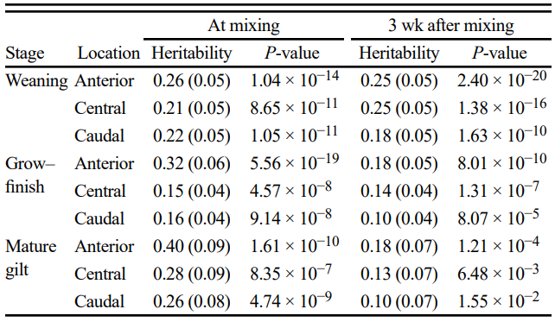
Heredabilidades
Wurtz et al 2017. J. of Anim. Sci. 95(10): 4310-4317

Slide 15
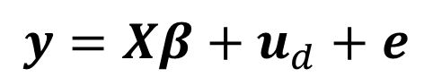
Una limitante de los resultados presentados
Presentamos efectos genéticos directos. Son estimadores de la heredabilidad de la adquisición de lesiones en la piel.
Es decir podíamos llamarlo “efecto víctima”, porque es el efecto del animal que recibe la lesion, no del que la causa.
$$y=Xβ+u_{d}+e$$

Slide 16
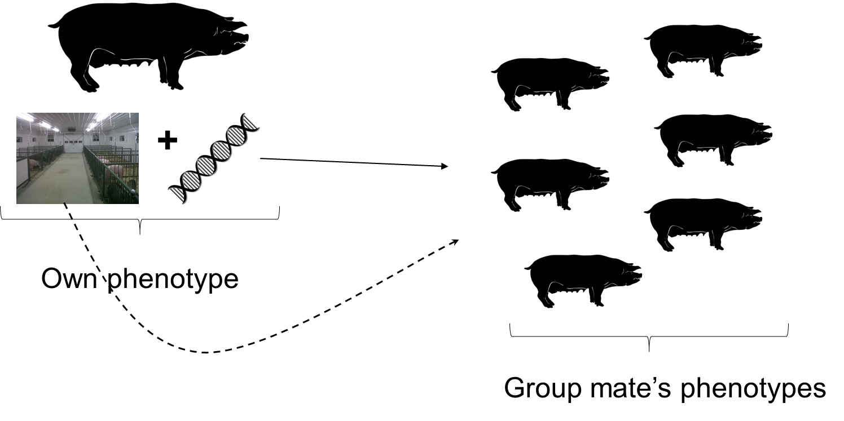
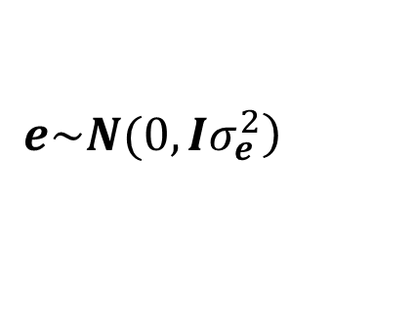
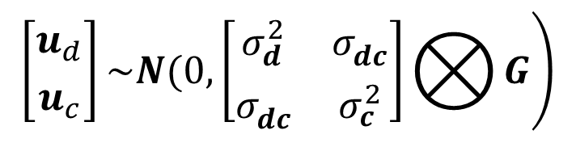
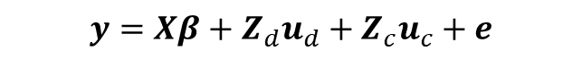
Efecto genético directo e indirecto
$$y=Xβ+Z_{d}u_{d}+Z_{c}u_{c}+e$$
$$\left.\left[{u_{d} \atop u_{c}}\right]\sim N(0,\left[\begin{matrix}σ_{d}^{2} & σ_{dc}^{} \\ σ_{dc}^{} & σ_{c}^{2}\end{matrix}\right]⨂{G}\right)$$
Matriz de efectos
geneticos sociales
$$\left.e\sim N(0,Iσ_{e}^{2}\right)$$
Notes:
A social breeding value is a type of indirect genetic effect. All of you are familiar with direct genetic effects, where the phenotype of an individual is assumed to be the result of the genetic make up of the individual expressed in a certain environment.
An indirect social genetic effect pertains to the effects of the genetic makeup of an individual on the expressed phenotypes of its social group mates. Of course, the phenotype of the individual in the social group are the result of their own genotype, plus the environment where that genotype is expressed, but also is affected by the genotype of the group mate. Estimation of those effects are social breeding values
Observe also that what is consider an environmental effect (pen for instance), direct genetic effect (familial groups) and social genetic effects (co-housed familiar groups) can be partially confounded to the point that they can’t be separated using a statistical model

Slide 17
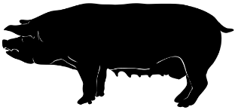
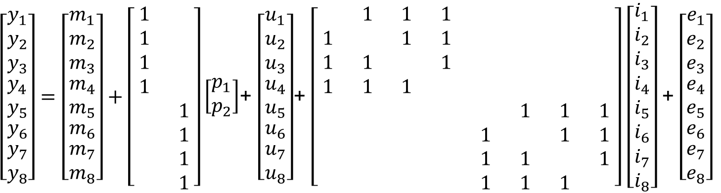
Podemos separar efectos genéticos sociales de efectos promedio de grupo?
2
7
1
5
Color:
full sibs
4
8
3
6
Pen 1
Pen 2
$\left[\begin{matrix}\begin{matrix}\begin{matrix}y_{1} \\ y_{2} \\ y_{3}\end{matrix} \\ y_{4} \\ y_{5}\end{matrix} \\ y_{6} \\ \begin{matrix}y_{7} \\ y_{8}\end{matrix}\end{matrix}\right]=\left[\begin{matrix}\begin{matrix}\begin{matrix}m_{1} \\ m_{2} \\ m_{3}\end{matrix} \\ m_{4} \\ m_{5}\end{matrix} \\ m_{6} \\ \begin{matrix}m_{7} \\ m_{8}\end{matrix}\end{matrix}\right]+\left[\begin{matrix}1 & \\ 1 & \\ 1 & \\ 1 & \\ & 1 \\ & 1 \\ & 1 \\ & 1\end{matrix}\right]\left[\begin{matrix}p_{1} \\ p_{2}\end{matrix}\right]$+ $\left[\begin{matrix}\begin{matrix}\begin{matrix}u_{1} \\ u_{2} \\ u_{3}\end{matrix} \\ u_{4} \\ u_{5}\end{matrix} \\ u_{6} \\ \begin{matrix}u_{7} \\ u_{8}\end{matrix}\end{matrix}\right]$+ $\left[\begin{matrix} & 1 & 1 & 1 & & & & \\ 1 & & 1 & 1 & & & & \\ 1 & 1 & & 1 & & & & \\ 1 & 1 & 1 & & & & & \\ & & & & & 1 & 1 & 1 \\ & & & & 1 & & 1 & 1 \\ & & & & 1 & 1 & & 1 \\ & & & & 1 & 1 & 1 & \end{matrix}\right]$ $\left[\begin{matrix}\begin{matrix}\begin{matrix}i_{1} \\ i_{2} \\ i_{3}\end{matrix} \\ i_{4} \\ i_{5}\end{matrix} \\ i_{6} \\ \begin{matrix}i_{7} \\ i_{8}\end{matrix}\end{matrix}\right]$+ $\left[\begin{matrix}\begin{matrix}\begin{matrix}e_{1} \\ e_{2} \\ e_{3}\end{matrix} \\ e_{4} \\ e_{5}\end{matrix} \\ e_{6} \\ \begin{matrix}e_{7} \\ e_{8}\end{matrix}\end{matrix}\right]$
Notes:
Suppose that now, in this model we want to estimate also the indirect genetic effect. A social effect.
For that we need to expand the model adding this term, here. Observe how is the incidence matrix that links phenotypes to social effects.
For the observed phenotype of the production trait in animal 1, the corresponding row of the incidence matrix of the social effects has all zeros, except for animals 2,3,4 that are in the same social group of animal one. For animal (row) 8, the 1s correspond to columns (animals) 5,6,7. And so on.
Well. Depending on the type of relationships between animals, this social genetic effect may not be estimable, because it may be confounded with the pen effect. One social group in one pen.

Slide 18
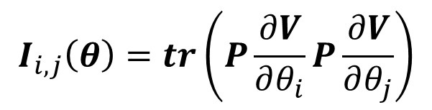
Identificabilidad de los components de varianza
$$var\left(y\right)=V=V_{1}θ_{1}+V_{2}θ_{2}+…+V_{k}θ_{k}$$
$$PX=0, P=V^{−1}−V^{−1}X{\left(X^{′}V^{−1}X\right)}^{−1}X^{′}V^{−1}$$
Identifiability of variance components under translation invariance requires that the smallest eigenvalue of the REML information matrix $I(θ)$ is positive.
$$I_{i,j}\left(θ\right)=tr\left(P\frac{∂V}{∂θ_{i}}P\frac{∂V}{∂θ_{j}}\right)$$

Slide 19
Resultados con el modelo tradicional (DGE)
Lesion scores

Slide 20
Cómo mejorar la estimación de estos efectos?
Un supuesto muy restrictivo de estos modelos es que todos los animales en un grupo social interactúan de manera uniforme con cada uno de los miembros del grupo.
Otro supuesto es que los efectos sociales o de competencia son constantes en el tiempo.
Es posible relajar estos supuestos?

Slide 21
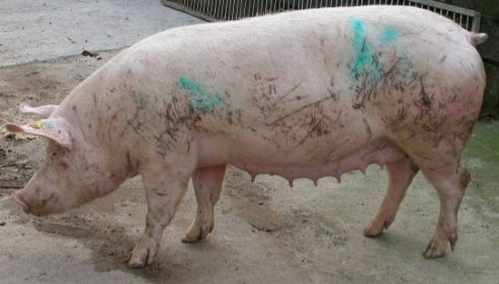
Relación entre comportamiento y conteo de lesiones según posición en el cuerpo: Nuestros resultados
Reciprocal Fights
h²= 0.1-0.15
Delivery of bullying
Receipt of bulling
r_{g}=0.45
r_{g}=0.75
r_{g}=0.6
©Pig 333

Slide 22
Intensidad de interacción o competencia
Cuantificamos la intensidad de interacción entre todos los pares de animales en un grupo social.
Animal ID in a group
Ejemplo:
Los elementos de esta matriz son el numero de minutos que cada par de animals transcurre peleando entre sí.
Incluye: peleas recíproas, ataques, y otras interacciones agresivas.
Animal ID in a group
Notes:
But we can do much better than that if we incorporate behavioral observations.
Suppose we can quantify pairwise interaction between all pairs of individuals in the social group. In this case we have seconds engaged in aggressive interactions (reciprocal fights, attacks, etc) by each pair of individuals in a 24 hour period immediately post mixing. This matrix is much more informative than a matrix with 1 and 0, because it quantifies the intensity of interaction.
And if you are able to create weighted edges to build social networks as the ones presented in the first session today, you can generate these matrices!

Slide 23
Qué tan heterogeneas son estas interacciones. Ejemplos de 3 corrales en nuestra población.
Notes:
A natural question then is: is there enough heterogeneity. And as you, behaviorists know better than me, in general there is. These are undirected graphs build from interaction matrices based on real data from three social groups, each housing about 14 pigs. The nodes represent pigs and the thickness of each edge connecting a pair of nodes indicates the intensity with which they interacted.
Let’s focus on this one here. Under a classic social genetic effect model, all edges would have the same thickness. For instance, the phenotype of animal 13 would be apportioned equally to the social effects of all social group mates. But if we use the matrix that this graph is representing, then the phenotype of animal 13 would contribute much more heavily to the estimated social genetic effect of animal 2, animal 1 and in a bit less animals 9 and 4, and very, very little if anything to the estimation of social effects of other animals.
More importantly, the structure of the networks are very unique of each social group, so even over remixing this approach would be extremely and uniquely informative compared to the traditional assumption of uniform interactions.

Slide 24
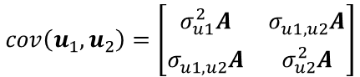
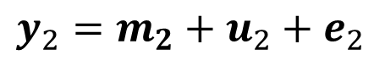
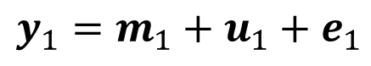
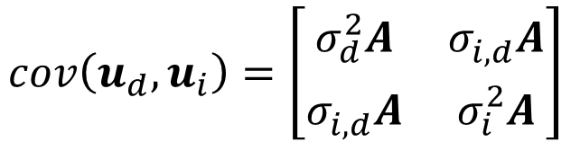
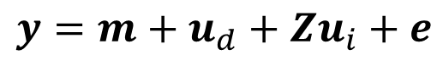
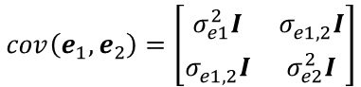
Y cómo difiere este analysis del modelo bivariado donde comportamiento y lesiones se modelan como dos caracteres correlacionados?
El modeo bivariado estima parámetros geneticos DIRECTOS genetic entre tiempo total de interacción y conteo de lesiones para cada animal.
El modelo genetico social con intensidad de interacción utiliza datos DIADICOS de tiempo de interacción para modelar efectos sociales en el character de conteo de lesiones.
El Modelo de efectos sociales utiliza información que se pierde en el modelo bivariado al sumar las interacciones.
Animal ID in a group
Sum columns
Animal ID in a group
$$y_{2}=m_{2}+u_{2}+e_{2}$$
$$y=m+u_{d}+Zu_{i}+e$$
$$y_{1}=m_{1}+u_{1}+e_{1}$$
$$cov\left(e_{1}, e_{2}\right)=\left[\begin{matrix}σ_{e1}^{2}I & σ_{e1,2}^{}I \\ σ_{e1,2}^{}I & σ_{e2}^{2}I\end{matrix}\right]$$
$$cov\left(u_{d}, u_{i}\right)=\left[\begin{matrix}σ_{d}^{2}A & σ_{i,d}^{}A \\ σ_{i,d}^{}A & σ_{i}^{2}A\end{matrix}\right]$$
$$cov\left(u_{1}, u_{2}\right)=\left[\begin{matrix}σ_{u1}^{2}A & σ_{u1,u2}^{}A \\ σ_{u1,u2}^{}A & σ_{u2}^{2}A\end{matrix}\right]$$
Notes:
A natural question here is, how is this model different from fitting a multivatiate model where one trait is the phenotype of interest, and the other trait is the total interaction time per animal.
For instance, in this case, we sum for each row over all columns, and come up with the total time each animal was engaged into aggressive interactions, then we treat this as a second variable in a bi-variate model, together with the phenotype of interest. In this case, we could estimate (DIRECT) genetic correlations and phenotypic correlations between the trait of interest and the behavioral trait. Notice that the information on dyadic interactions is lost in this process.
But with the intensity of competition model, we don’t estimate genetic correlations between direct genetic effects, we would estimate correlations between the indirect and the direct genetic effect, conditional on the intensity of dyadic behavioral interactions.
We are truly modeling different population parameters

Slide 25
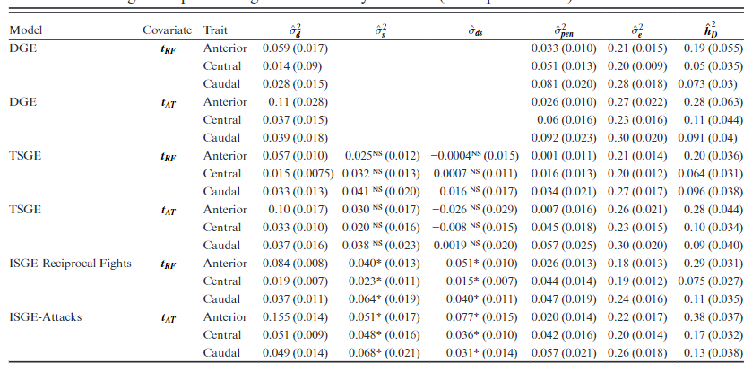
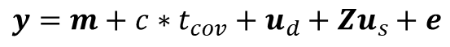
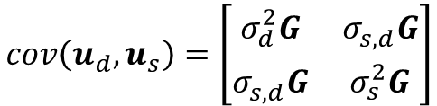
Resultados
$$cov\left(u_{d}, u_{s}\right)=\left[\begin{matrix}σ_{d}^{2}G & σ_{s,d}^{}G \\ σ_{s,d}^{}G & σ_{s}^{2}G\end{matrix}\right]$$
$$y=m+c∗t_{cov}+u_{d}+Zu_{s}+e$$
Angarita Barajas et at 2019. JAS 97(9):3658-3668

Slide 26
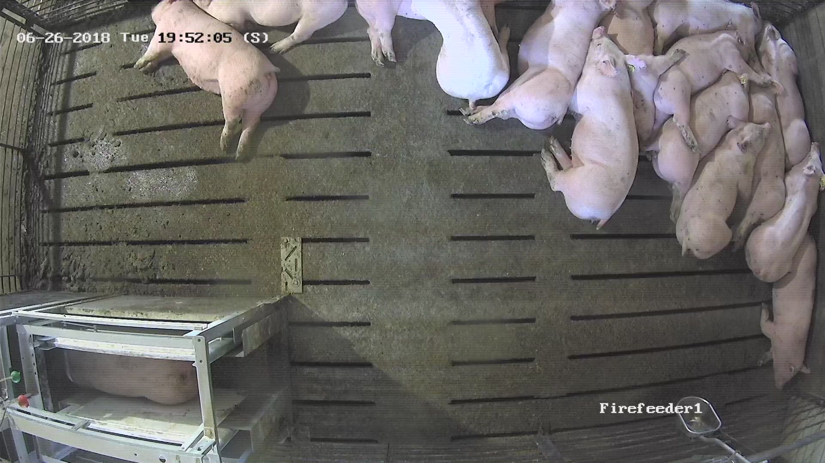
Cómo registrar datos de comportamiento? Analisis de imagenes y videos

Slide 27
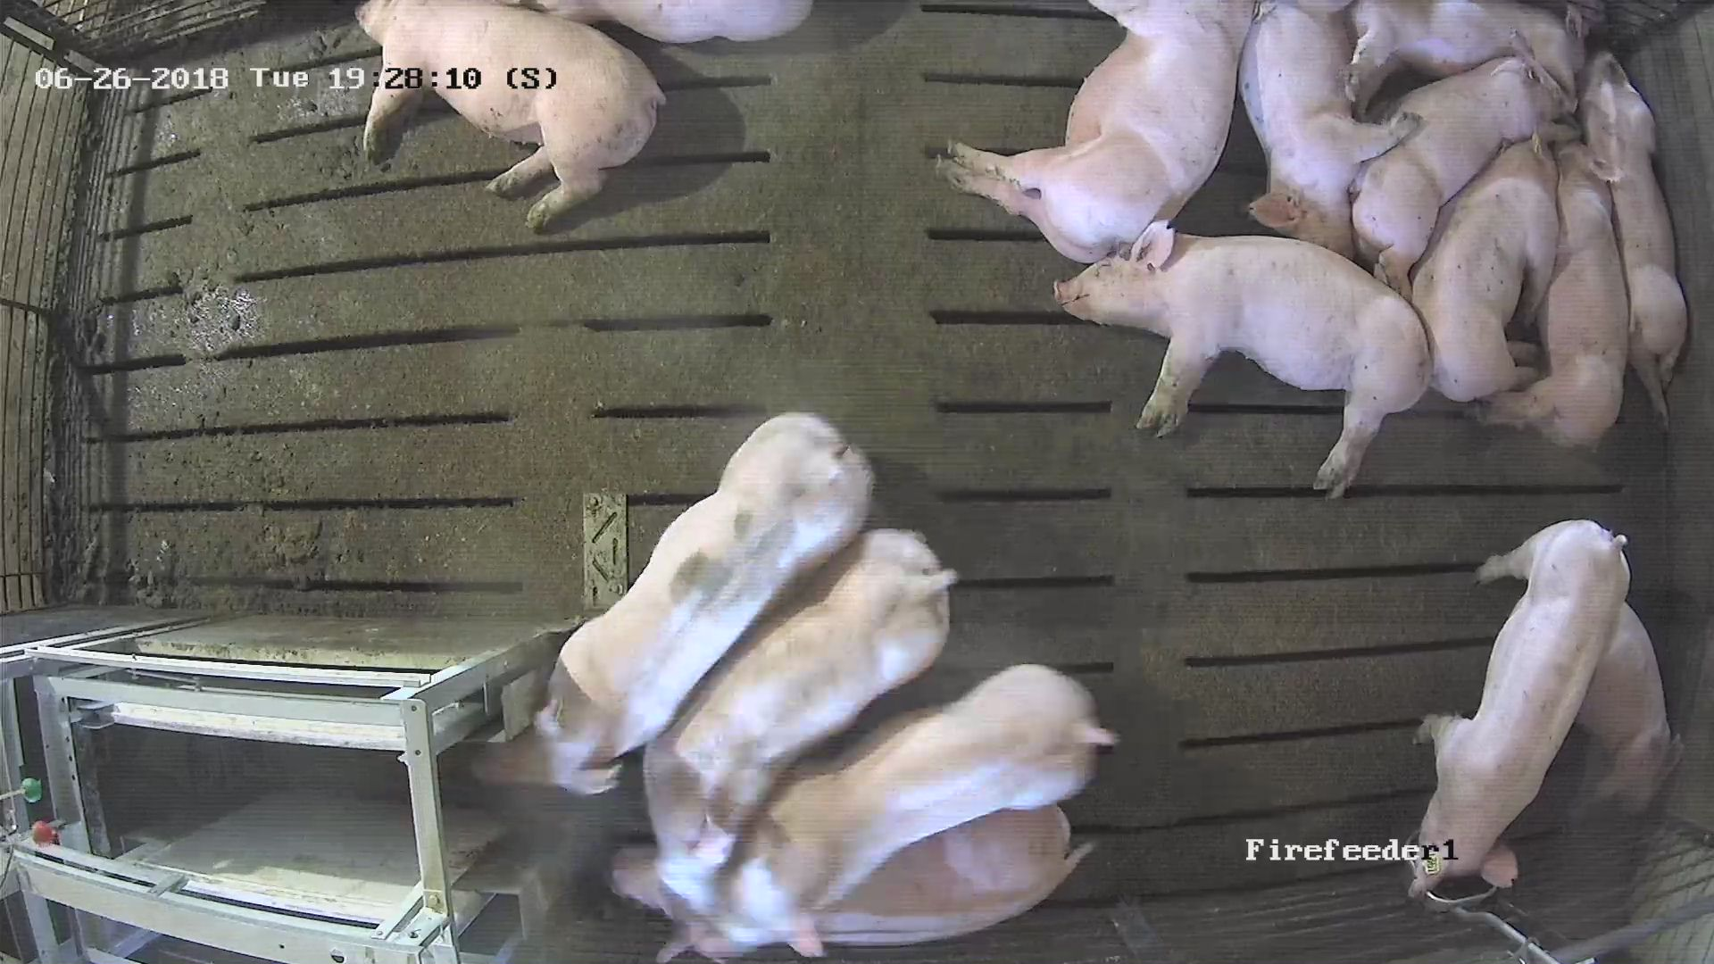
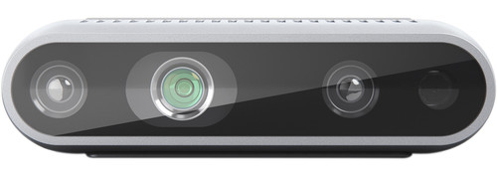
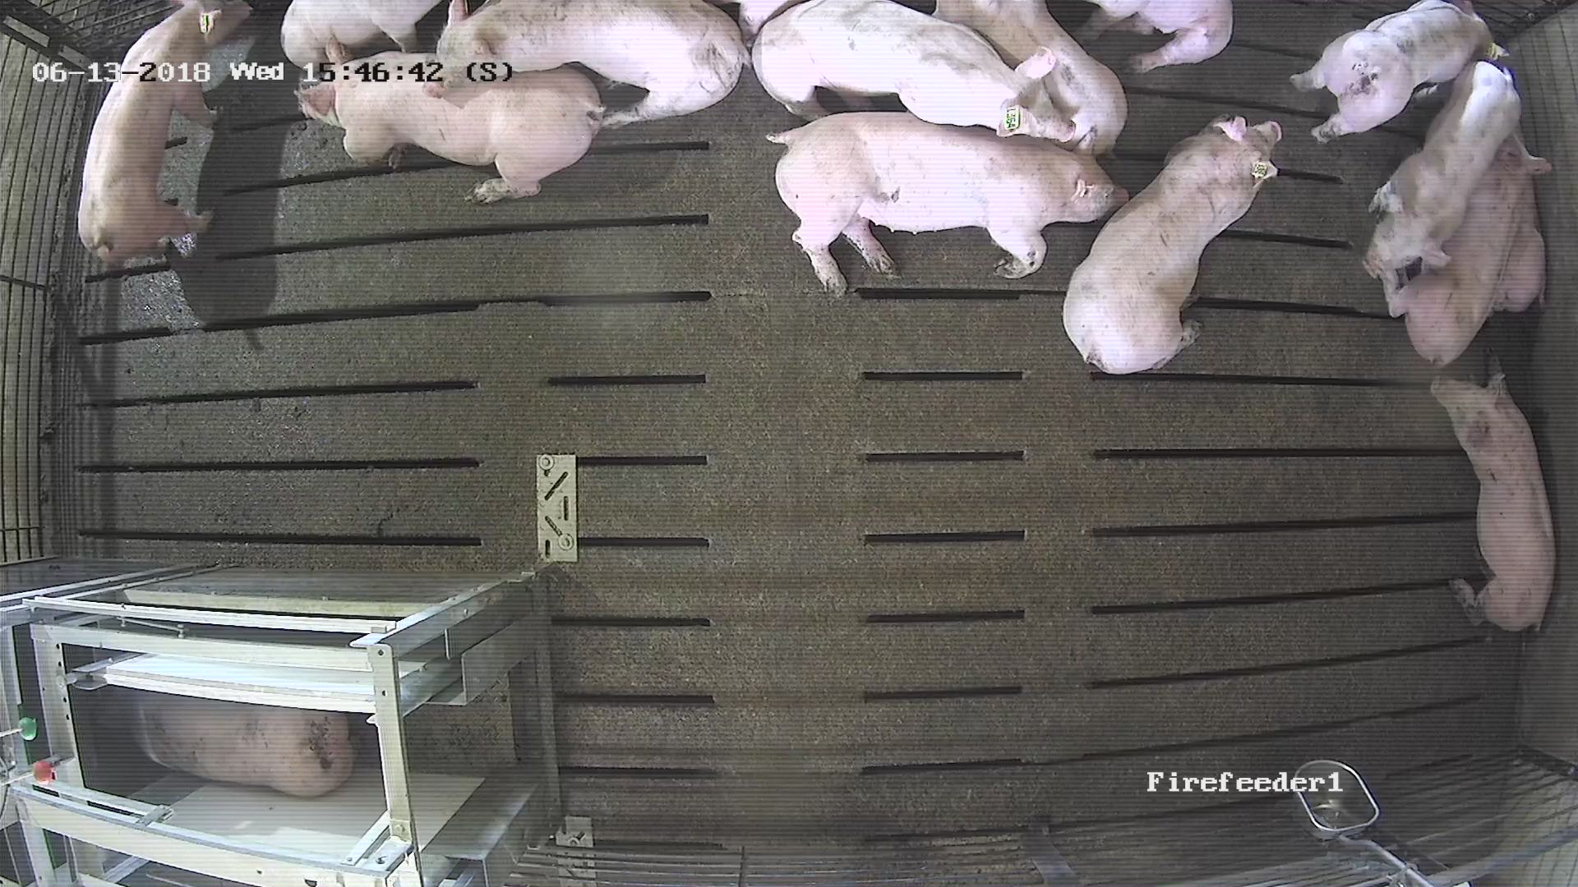
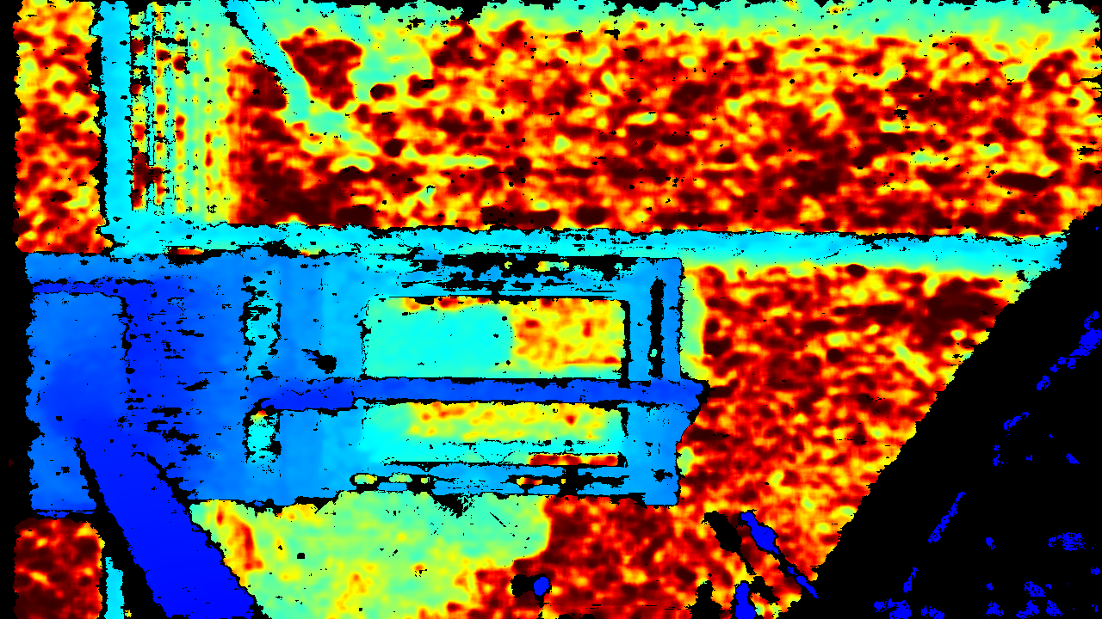
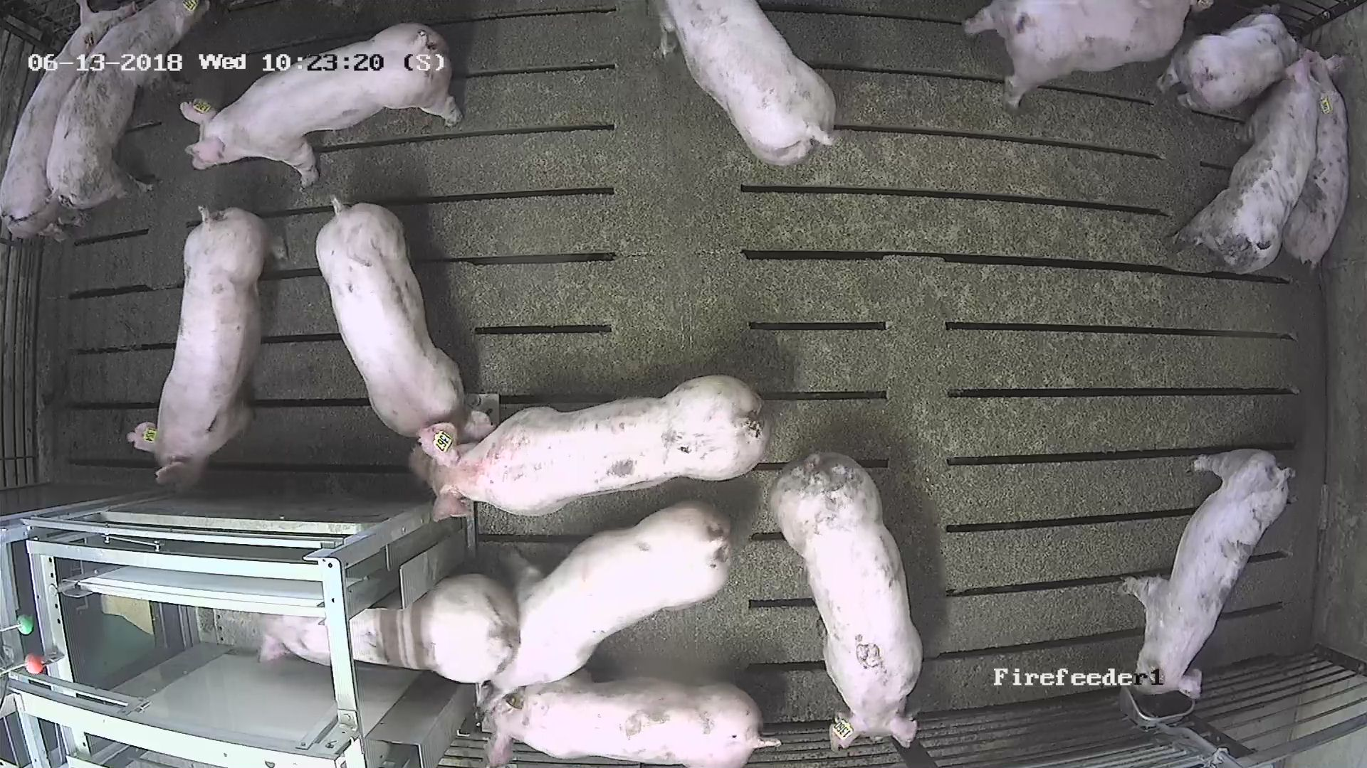
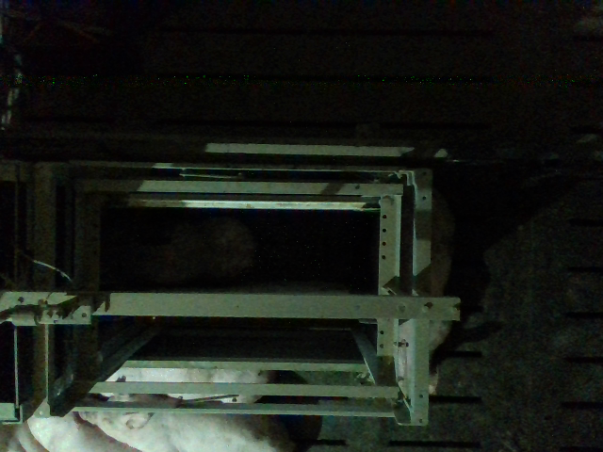
Análisis de ocupación de comederos Alimentamos un modelo de redes neuronales (DL) con imágenes de comederos vacios y ocupados. De día y de noche (flash infrarrojo o imagenes 3D)
Podemos construir una NN que automaticamente clasifica imagenes en tres estados:
Comedero vacio vs ocupado
Ocupado por 1 o por >1 cerdo
Si un comedero está ocupado por mas de un cerdo, el segundo animal seguramente interfiere con el consume del primer animal.

Slide 28
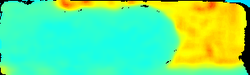
Images as data
Dataset 1: N=652 for training, N=1000 for validation
Colorful Depth
Optimizamos los hiperparametros de la red neuronal con un algoritmo evolucionario
Optimizer | Activation | N layers | Nodes(L1) | Nodes(L2) | Nodes(L3) | Dropout | L2 penalty
sgd | relu | 3 | 244 | 77 | 27 | 0.255 | 0.020
sgd | relu | 3 | 376 | 105 | 27 | 0.029 | 0.096
sgd | relu | 3 | 376 | 67 | 28 | 0.297 | 0.058
sgd | relu | 3 | 448 | 105 | 27 | 0.025 | 0.062
sgd | relu | 2 | 376 | 28 | NA | 0.269 | 0.279
Notes:
Then, crop the area of interest and resize it. And this will be the input of our model. Train a hierarchical model using some of the pictures from first day of filming and save the model. And use the model to predict all the pictures collected in 3 days. For us it is impossible to label all 64,000 pictures manually. Instead, we randomly sampled 1000 pictures and labelled them. Then we compare the manually labelled result to the model prediction.

Slide 29
Resultados
MLP o “Multi Layer Perceptron”
Accuracy mean | Accuracy SD | Sensitivity mean | Sensitivity SD | Specificity mean | Specificity SD
0.982 | 0.009 | 0.998 | 0.005 | 0.832 | 0.111
CNN o Convolutional Neural Network
Accuracy mean | Accuracy SD | Sensitivity mean | Sensitivity SD | Specificity mean | Specificity SD
0.969 | 0.011 | 0.979 | 0.005 | 0.959 | 0.026

Slide 30
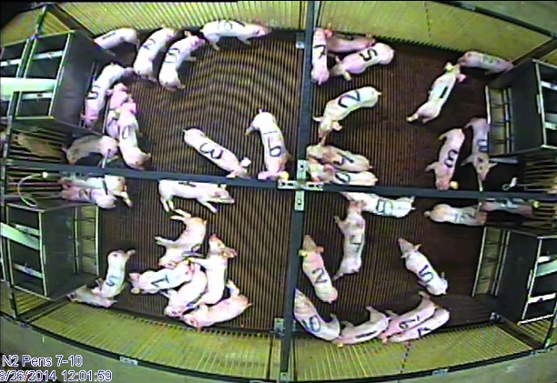
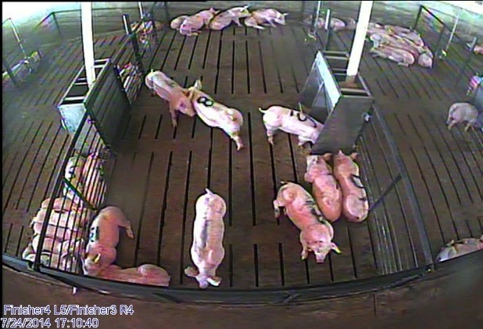
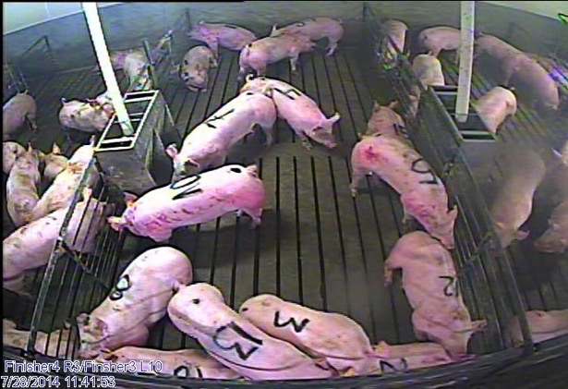
Observaciones de comportamiento
Nursery
Finisher
Gilt

Slide 31
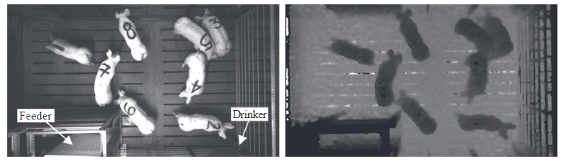
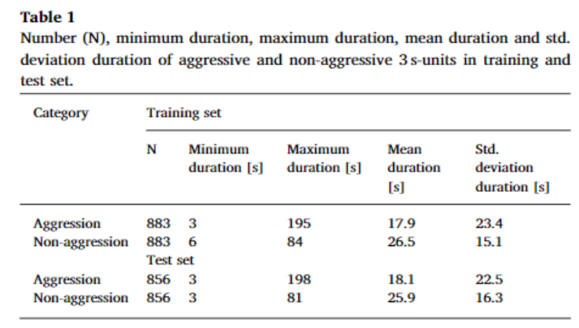
Detección automatica de agresión
Detection of aggressive behaviours in pigs using a RealSense depth sensor. Chen et al.
Computers and Electronics in Agriculture 166 (2019) 105003.

Slide 32

Substracción del background

Slide 33

Método de diferencia entre cuadros

Slide 34

Extracción de estadísticos relevantes del índice de movimiento

Slide 35

Resultados de clasificador SVM basado en estadísticos del índice de movimiento
Usando análisis de imágenes, detección de objetos, estadísticos de movimiento y machine learning, Podemos detector agresión con alta especificidad y sensibilidad.
Pero aún no Podemos saber quién pelea con quién: Animal ID!

Slide 36
Qué otras tecnologías podríamos usar para mejorar la estimacion de modelos de competencia?
En grupos estables (luego que la jerarquia social ha sido establecida) las interacciones agresivas mas communes suelen suceder en los comederos.
Podemos usar datos de comederos automaticos para cuantificar competencia?

Slide 37


Datos de comederos automátucos: Más allá de “Residual Feed Intake” (RFI) Y Ganancia promedio (ADG)
Tiempo y duración de las comidas
Peso
(Se usa para: ADG)
Alimento utilizado
(se usa para RFI)
El análisis tradicional de registros es generalmente “linea por linea”. Se ignora la información de la secuencia.
Fama de ser datos “ruidosos”

Slide 38






Análisis de secuencias de visitas
Hay influencia del animal “seguidor” en la duración de la comida de un animal?
Podemos analizar la secuencia de visitas e incluir un efecto del animal seguidor:
$${visit_length}_{ijk}=μ_{i}+d_{j}+f_{j′}+e_{ijk}$$
$$\left.e_{ijk}\sim N(0, σ_{e}^{2}\right)$$
$$\left.d_{j}\sim N(0, σ_{D}^{2}\right)$$
$$\left.f_{j}\sim N(0, σ_{C}^{2}\right)$$
$$cov\left(f_{j},d_{j}\right)=?$$

Slide 39
Análisis de secuencias de visitas
Más supuestos: si el tiempo transcurrido entre la salida de un animal del comedero y la entrada de su seguidor es suficientemente largo, no debería haber efecto del seguidor (~eventos independientes)
En este análisis
Separamos los datos en dos grupos:
Cuando el reemplazo se produjo en menos de 60 segunos.
Cuando el reemplazo se produjo mas de 5 minutos mas tarde.

Slide 40
Análisis de secuencias de visitas: datos
 | Reemplazos Inmediatos | Reemplazos distantes | Datos completos
Número de animals | 118 | 118 | 118
Grupos de contemporá-neos | 12 | 12 | 12
Número de registros | 50652 | 6340 | 66780
Tiempo de reemplazo | <60 s. | >600 s. | NA
Variable respuesta: tiempo en el comedero (solo mide mientras el animal come).
Covariable: Peso del animal

Slide 41
Análisis de secuencias de visitas: Resultados
Parámetros de la distribución posterior en tres modelos
Mod. | Param | Reemplazos inmediatos |  |  |  | Reemplazos distantes
 |  | media | Q 2.5 | Q 50 | Q 97.5 | media | Q 2.5 | Q 50 | Q 97.5
M1 | % V-D | 0.178 | 0.142 | 0.177 | 0.223 | 0.192 | 0.147 | 0.191 | 0.248
M2 | % V-D | 0.175 | 0.139 | 0.173 | 0.219 | 0.192 | 0.147 | 0.191 | 0.247
 | % V-C | 0.023 | 0.017 | 0.022 | 0.030 | 0.001 | 0.000 | 0.000 | 0.004
M3 | % V-D | 0.176 | 0.140 | 0.174 | 0.220 | 0.193 | 0.148 | 0.192 | 0.249
 | % V-C | 0.023 | 0.017 | 0.023 | 0.030 | 0.001 | 0.000 | 0.001 | 0.005
 | Cor D-C | 0.061 | -0.143 | 0.061 | 0.262 | -0.360 | -0.937 | -0.412 | 0.539
% V-D: proporción de varianza explicada por el efecto directo. % V-C: proporción de varianza explicada por el efecto del seguidor (competencia). Cor D-C: correlación posterior entre efecto directo y de competencia.
El seguidor explica una cantidad menor de varianza, pero es un componente significativo en visitas inmediatas. El efecto directo y de competencia parecen no estar correlacionados. Necesitamos investigar mas ☺

Slide 42
Conclusiones
Necesitamos ir más allá de estimar correlaciones entre caracteres.
Una posibilidad es utilizar efectos genéticos sociales
El registro automatico de comportamiento es absolutamente necesario para implementar modelos de efectos sociales
Análisis automático de videos
Registros de comederos automáticos
Datos de otros dispositivos?
Sensores de proximidad!

Slide 43
El futuro: Integrar datos en ganadería de precisón (manejo y selección)
Unidad física de alojamiento/ corral
comedero
Procesamiento de datos de comederos
Mas fenotipado!!
Recolección de datos
Calibración registro, etc.
Reporte de comportamiento ingestivo
Reporte de performance productiva
Cámara
Detección y reporte de errores
reporte de comportamiento
Reporte de interacción
Sistema físico de fenotipado
Procesamiento de imagenes y videos
Management decision
Selection decision
Cyber infrastructura (analisis y almacenamiento)
Flujo de datos crudos
Sistema de reporte
Resultados (datos procesados)
Alarmas (información destilada)
Decisiones/Acciones

